Slide 1
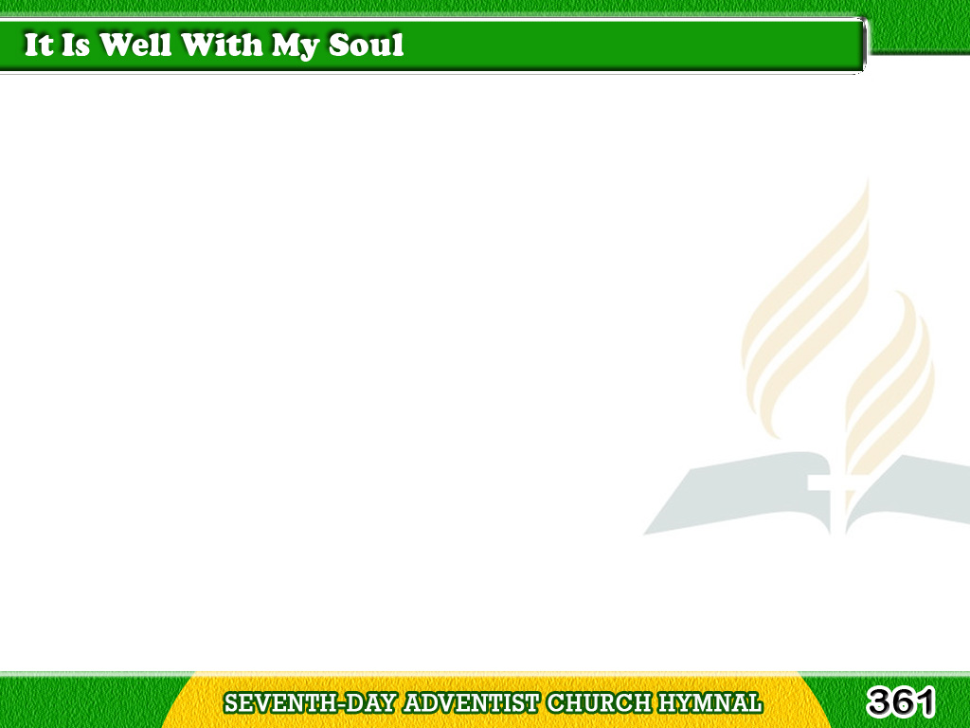
1/3
When peace, like a river,
attendeth my way,
When sorrows
like sea billows roll
Tagalog
Version

Slide 2
1/3
Whatever my lot,
Thou hast taught me to say,
It is well, it is well
with my soul.
Tagalog
Version

Slide 3
1/3
Chorus
It is well with my soul,
It is well, it is well
with my soul.
Tagalog
Version

Slide 4
2/3
My sin O the joy
of this glorious thought
My sin, not in part,
but the whole,
Tagalog
Version

Slide 5
2/3
Is nailed to the cross,
and I bear it no more:
Praise the Lord,
praise the Lord, O my soul!
Tagalog
Version

Slide 6
2/3
Chorus
It is well with my soul,
It is well, it is well
with my soul.
Tagalog
Version

Slide 7
3/3
And, Lord, haste the day
when my faith shall be sight,
The clouds be rolled back
as a scroll:
Tagalog
Version

Slide 8
3/3
The trump shall resound
And the Lord shall descend,
“Even so” it is well
with my soul.
Tagalog
Version

Slide 9
3/3
Chorus
It is well with my soul,
It is well, it is well
with my soul.
Tagalog
Version

